Slide 1

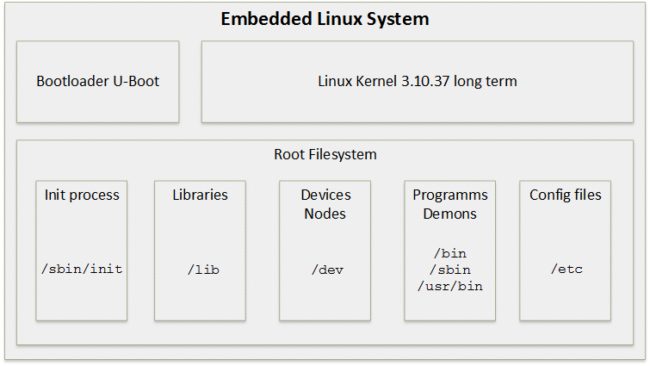
The X-Copter Project: Linux
University of
Applied Sciences
Buildroot

Slide 2
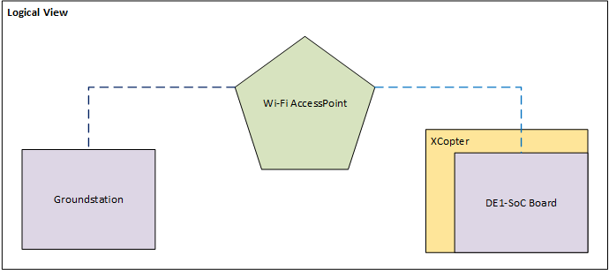
The X-Copter Project: Linux
University of
Applied Sciences
Wi-Fi
Automatically Connection at start up
Stable link to access point
Encrypted communication with WPA2

Slide 3
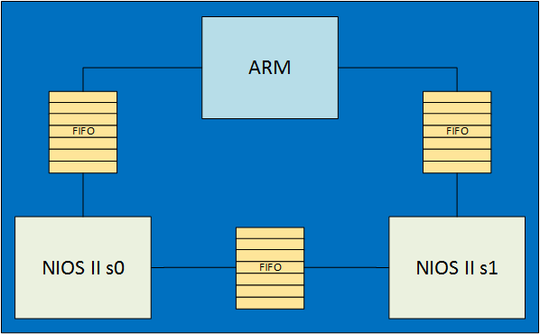
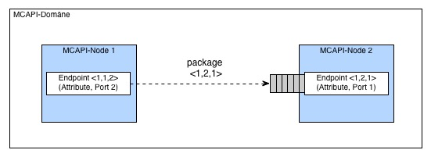
The X-Copter Project: Linux
University of
Applied Sciences
MCAPI
Interprocessor communication
FIFO based

Slide 4
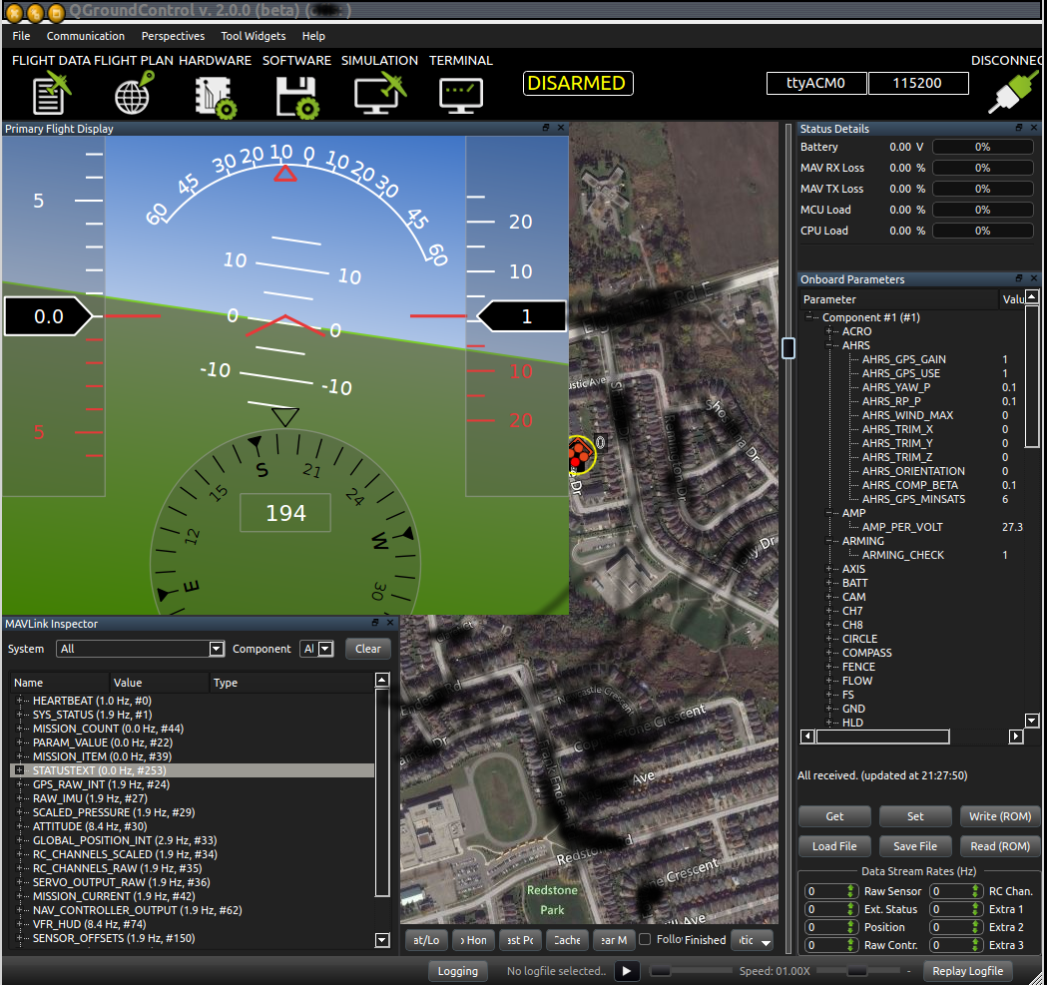

The X-Copter Project: Linux
University of
Applied Sciences
MAVLink
Micro Air Vehicle Communication Protocol
Communication protocol between UAV and ground station
C library for header based messaging
QGroundControl

